Slide 1
Nakuja Internship 2026
Solid Propulsion Team
Weekly report #4
Presented by: Paschal Peter
July 10, 2026

Slide 2
Tasks completed this week
Pyrogenic ignitor testing
Cooking of grains for one grain static test
Catalyst determination from Chemistry labs
Dry run
One grain static fire test

Slide 3
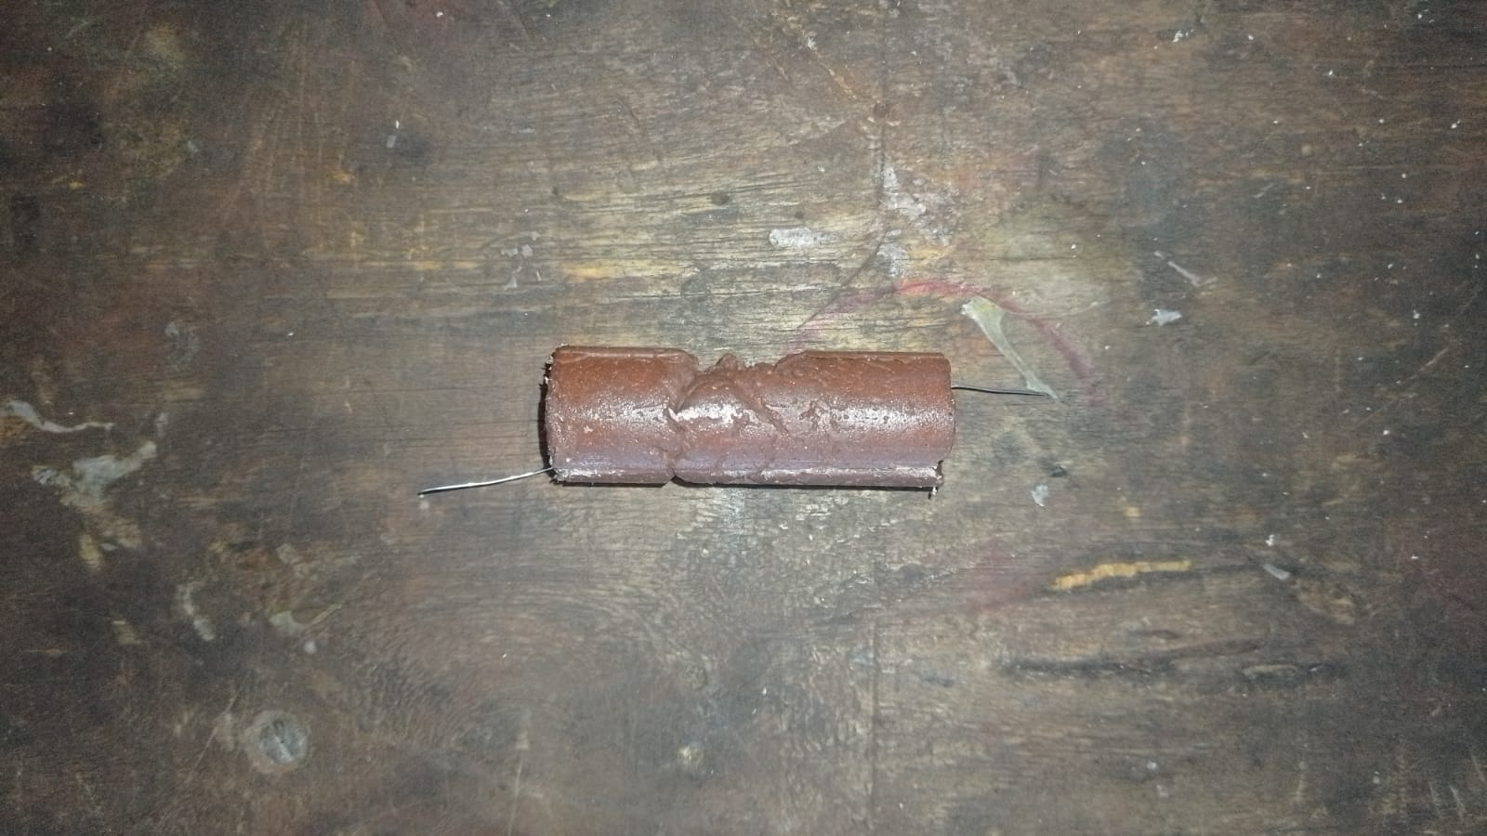
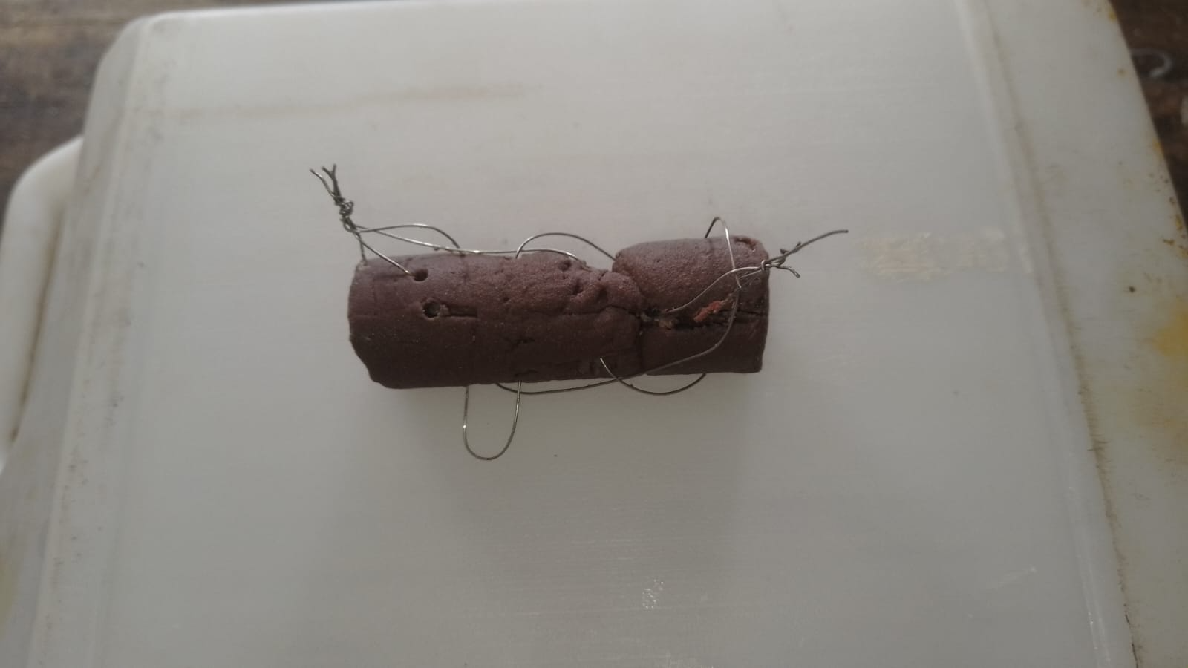
Pyrogenic ignitor testing
Purpose: For effective Solid Rocket Motor (SRM) ignition, the pyrogenic ignitor used has to have a very short burn time to provide as much heat to the grains as possible and reach the required SRM chamber pressure.
The first test done was to try to reduce the burn time of the ignitor by increasing the number of nichrome wires in the ignitor from one to three.
Previous design: New design:
Result: This resulted in a shorter burn time i.e 5.25 seconds for the previous design and 5.12 seconds for the new design, a 2.5% improvement. Our aim is to reduce the burn time upon subsequent tests.

Slide 4
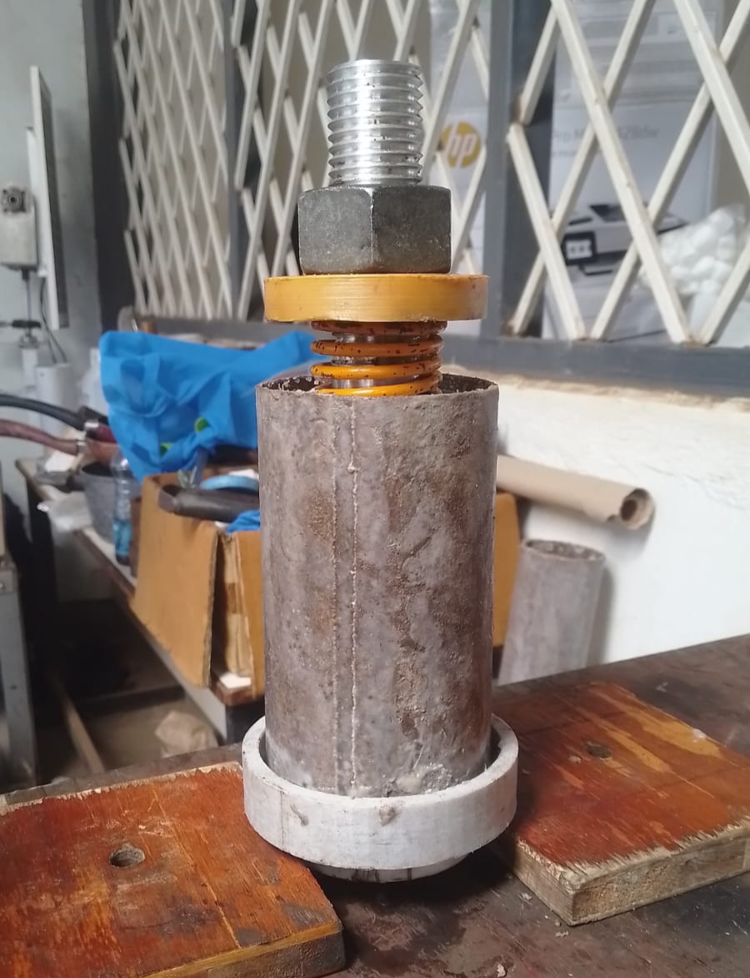
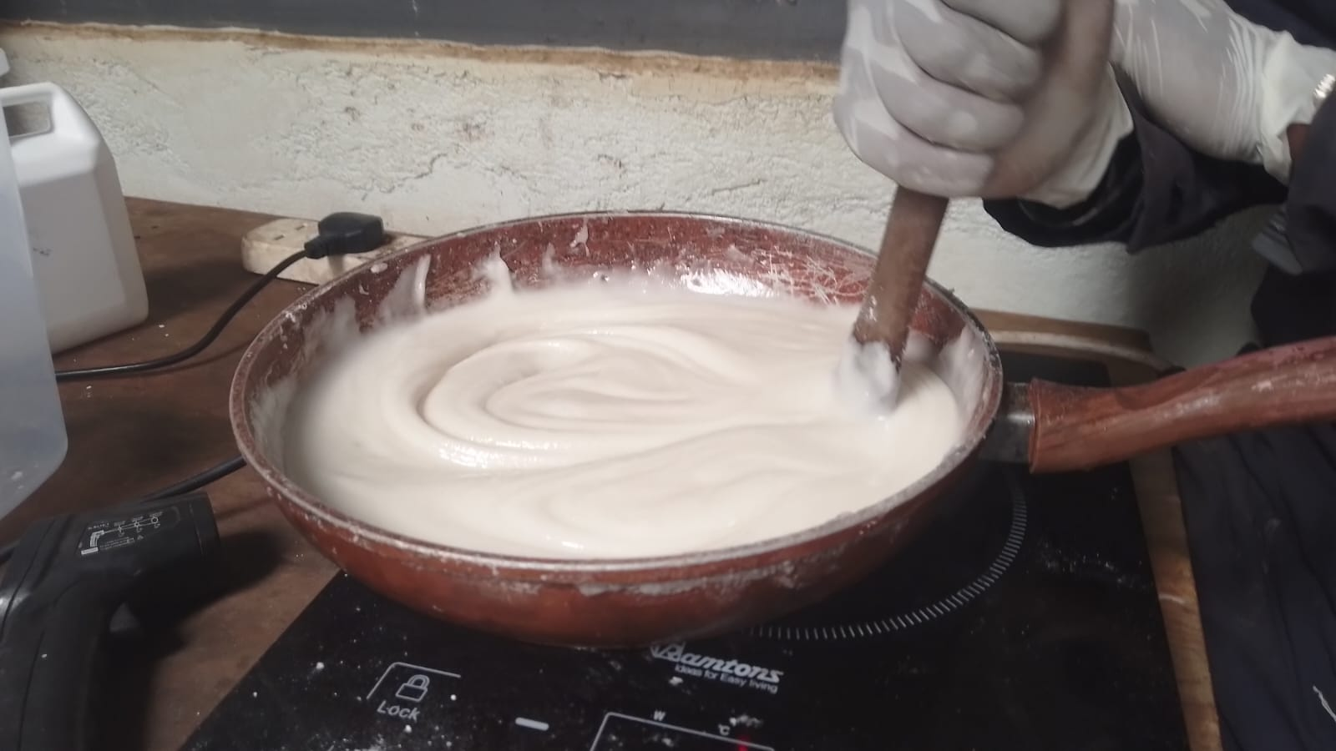
2. Cooking of grains for one grain static test
Purpose: Two Potassium Nitrate & Sorbitol (KNSB) propellant grains were prepared using the standard procedure documented here. This KNSB grain will be used as the control for our grain analysis test campaign.
The second prepared grain had an altered oxidiser to fuel ratio of 60:40 as opposed to the standard 65:35 making a slightly fuel rich mixture in an attempt to reduce thrust output
Control grain: Fuel rich propellant:

Slide 5
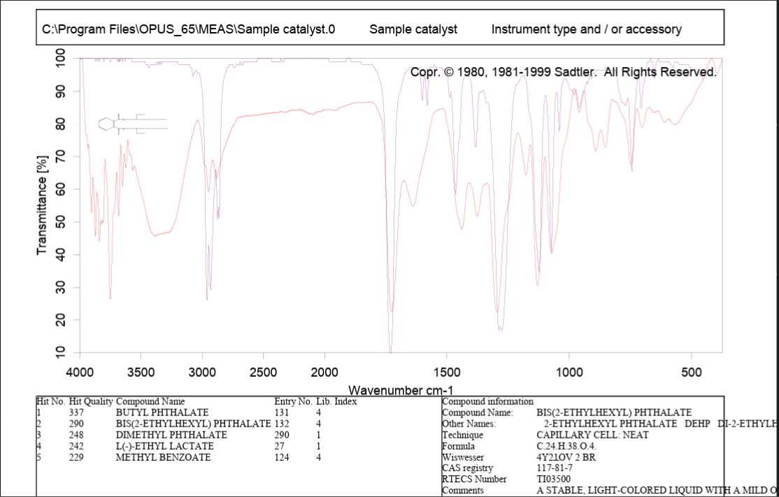
3. Catalyst determination from chemistry labs
Purpose: This experiment was done to help theoretically determine the correct epoxy to catalyst ratio to be used during liner preparation. Fourier-transform infrared spectroscopy (FTIR) and Atomic Absorption Spectroscopy (AAS) tests were done.
Result: The report is currently being written and will be uploaded to github once complete. The following were the FTIR test results. We await AAS test results.

Slide 6
4. Dry run
Purpose: This was done in preparation of the static test which is to be held on Friday 10/07/2026 and these were the objectives met:
Verify remote ignition circuit functionality using an empty Solid Rocket Motor (SRM).
Practice team coordination, timing, and emergency procedures.
Measure total setup-to-ignition time. 1hr 5mins (2:55 pm to 4pm) in our third attempt
Ensure all members are familiar with roles and safety protocols.
Identify any issues before the actual static test.
Challenges faced:
Load cell battery failure
Uncommanded ignition failure
The dry run report is documented here with the relevant photos and video uploaded to the joint album.

Slide 7
5. One grain static fire test
Purpose: This one grain static fire test will be used as the control or reference test in the coming subsequent tests. We will gather the data from this test and use it to improve our propellant grains.
Result: The static fire test was unsuccessful due to a faulty ignition wire which caused a short circuit which destroyed the mosfet, thus ignition did not take place.

Slide 8
Next week's tasks
Pyrogenic ignitor testing
Cooking of grains for one grain static test
Liner thickness testing (Burn test)
Purchasing of items i.e. Stainless steel casing, crafting paper
Nozzle and Bulkhead machining
3D print ignition circuit casing
One grain static fire test

Slide 9
Challenges experienced
None encountered
Supervisors’ note:
Visit Solid Propulsion github projects @ https://github.com/orgs/nakujaproject/projects/26 to review the tasks done.

Slide 10
Potential concerns
The load cell has a rating of 3000N while our expected peak thrust is 2500N which might require replacement of load cell
Concerns on test stand stability

Slide 11
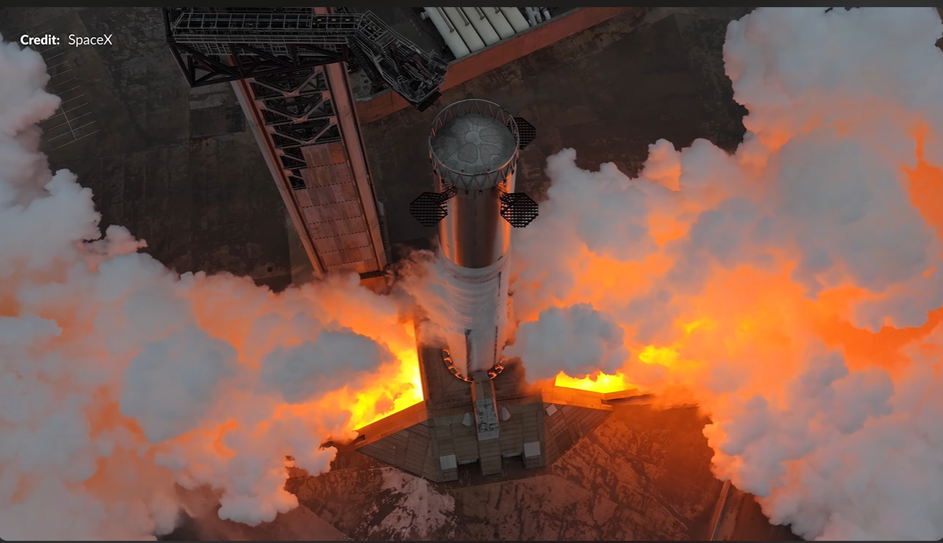
Thank you for your Attention!

